Slide 1


Autism Spectrum Disorder
April 5, 2023
Emily Whaland, MS, LPC
Notes:
Hi All. My name is Emily Whaland. I am the Lead Autism Care Manager here at Magellan for those that do not know me. I am very honored to have this be the fourth year I am presenting on this training topic. I would like this to be a very interactive training this year, so please feel free to chat, come off mute, and share along the way. Please get a pencil/pen and paper or pull up Microsoft word as we will use this later in the training.

Slide 2
Trainings in Review
2020: Understanding Autism and a review of the CDC and AAP Clinical Guidelines
2021: Fostering Autism diversity and an enhanced look at transition planning and collaboration of care
2022: Autism and the Clinical Practice Guidelines
2023: Accepting, Honoring & Empowering Autistic Voices
Notes:
As you know, I like to change this training topic every year and give you something different and try to present in a different training modality. For the last few years, I have been pushing to explore and share the shift from Autism Awareness to Autism Acceptance. This year, I really want to tune into Autistic Voices- honoring and empowering Autistic individuals through their shared stories. Today we will be hearing perspectives from those diagnosed with Autism and I hope to challenge you to look inward to break our own stigmas and stereotypes while learning how we can pay it forward as an ally and support this community. I want to be very clear that there is not a one size fits all approach and perspective to take. Individuals with Autism have different preferences- being referred to as Autistic versus an individual with Autism, versus an “Aspy” or self-identifying with Aspberger’s so if you are not sure how someone wants to be referred to as…ASK. I also want to be very clear that the transition from Awareness to Acceptance is still a work in progress and some people still use Autism Awareness lingo or symbols. That is okay. This shift will take time. The more education- the better.

Slide 3
Agenda
Autism Acceptance Versus Awareness Refresher & Why It Matters
Challenging Stigma and Stereotypes- Honoring and Accepting Autistic Voices
Next Steps to Get Involved & Show Support
Notes:
These are going to be the training topics we will review this training.
I will note this is not going to be a intro to Autism training. If you feel you need a intro review/ASD basics- please let me know and I will build this into Autism Acceptance Month. It is totally okay if you do!!

Slide 4
Acceptance Versus Awareness & Why It Matters
Notes:
So let’s get into agenda one- Acceptance versus awareness and most importantly why it matters

Slide 5
Acceptance versus Awareness
Awareness:
Acceptance:
“the quality or state of being aware: knowledge and understanding that something is happening or exists”- MW dictionary
“the quality or state of being accepted or acceptable, the act of accepting something or someone: the fact of being accepted: approval” –MW dictionary
Disease based language implying a cure needs to be found to resolve the condition and/or symptomology is seen as a weakness
Understanding and welcoming based language to create an inclusive environment
Allows for stereotyping, fear, and pointing out differences in a negative light
Autistic driven approach to creating opportunities for advocacy and action to destigmatize and break down societal barriers
Notes:
I am going to phone a friend and open it up to the group to share their ideas or what awareness means versus acceptance.
So let’s break this down further. Example 1- the definitions from a MW Dictionary. This doesn’t tell us too much. Awareness is a way to show us Autism is out there and it exists. But when you look at the definition of acceptance it is taking that knowledge of knowing something is out there and welcoming it and embracing it.
Now let’s look at 2nd set of examples. Often times we see awareness ribbons and symbols being utilized for cancers or some diseases. This creates an idea that there needs to be a cure. For example, my sister is currently undergoing treatment for breast cancer. In the breast cancer community as well as w/other cancers, there are ribbons to create awareness about breast cancer and provide education for screenings and treatments and to ultimately find a cure. Do you see how Cancer has a negative connotation? When you hear someone has cancer- ppl usually apologize and offer condolences. You wouldn’t do this for Autism. If I were to use the same with Autism, I would be saying “my sister is undergoing treatment for Autism” but ultimately there is no cure for Autism. It is not something that need a cure. Autism isn’t deadly. When we have a different approach via acceptance, we are aware something exists and are welcoming it. Autism is just a different way of thinking- it isn’t a deadly disease. If it is just a different way of thinking, why wouldn’t you want to provide an environment that supports that? BTW Autism Speaks members have really upset the Autism community in the past by comparing cancer and Autism- these are not comparable.
The last bullet point is Awareness allows for stereotyping and bucketing into different ideas of mainstream media portals of what Autism is. Acceptance is an Autistic community driven change to allow them to gain power over how Autism is portrayed and seen and to create opportunity to accept what needs to be done and what can be done to promote inclusion . Autism Awareness is usually contributed to Autism Speaks which a lot of individuals with Autism dislike and are not in agreement with. I could spend a whole training on that issue so I will not go into that today.

Slide 6
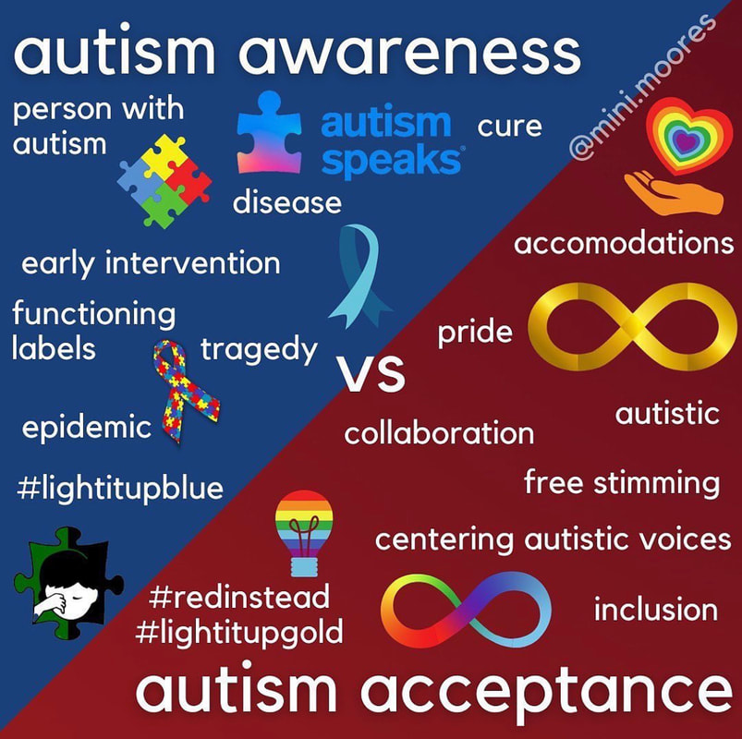
Acceptance versus Awareness
“I wish to live in a world where acceptance is not just the goal, but the reality. I want to live in a world where someone talking in the deficit model of awareness is regarded as uncomfortably out of touch with how things should be. This is my world too, and I want it to be filled with people who know that I am autistic and fantastic, not that I “have autism” and that is tragic. In my ideal world, flapping will be just as acceptable as smiling, earplugs will be a normal sight, AAC devices will be common and everyone will know how to converse with AAC users. In that world, neurodiversity will be just another way that people are unique, and everyone will agree that diversity is part of what makes the world so beautiful.”- Kassiane S. (ASAN)
Read More Below:
Acceptance vs. Awareness - Autistic Self Advocacy Network (autisticadvocacy.org)
Acceptance is an Action: ASAN Statement on 10th Anniversary of AAM - Autistic Self Advocacy Network (autisticadvocacy.org)
Notes:
I usually default to ASAN regarding Autism Acceptance Month information as they are run by Autistic People. I have included a few links below, please read them during this month at some point. I did want to share a quote from the Author of the one article regarding her view of this topic.
Read Quote
Please also reference the image on the right which is a visual representation of the view of autism awareness versus autism acceptance.
Break down symbols

Slide 7

“Autism Awareness – knowing autistic people exist. Autistic Acceptance – accepting autistic people as they are, strengths and weaknesses. Autistic Pride – Autistic people feeling safe & confident enough to have pride in their authentic neurodivergent selves #WorldAutismDay”
-Lyric Holmans of the NeuroDivergent Rebel
Notes:
I just found a few more quotes to bring us to our main theme of honoring and accepting Autistic voices that I would like to share
Read Quotes

Slide 8
“Moving from ‘awareness,’ which is often used in discourses on disease and illness, towards ‘acceptance,’ which is more positive, will help to destigmatize the condition and enable autistic people to speak about our condition on our terms.”
-Sarinah O’Donoghue
Notes:
Read Quote

Slide 9
“Creating awareness was the first step in our conversation about disability inclusion, however, acceptance enforces awareness and reflects how our society should celebrate the differences and abilities that neurodivergent people have.”
-Elle Love
Notes:
Read Quote

Slide 10
Acceptance versus Awareness
Awareness
Acceptance
How can neurotypical individuals get involved to support neurodiversity?
Action
Autism Spectrum Disorder
Connection
Advocacy
Notes:
I like to view the road ahead like this. We all know awareness laid the foundation to move towards acceptance but there is still more work to be done. Throughout this training- let’s think about what can be done. How can neurotypical individuals get involved to support neurodiversity?

Slide 11
Challenging Stigmas & Stereotypes
Accepting & honoring autistic voices
Notes:
Next we will move into challenging stigmas and stereotypes while accepting and honoring autistic voices

Slide 12

Challenging Stigma and Stereotypes
How do you define Autism? When you hear the word “Autism” what comes to your mind?
How have you seen Autism portrayed in the media?
What comes to mind when you think of the cause, the “cure”, and the treatment of Autism?
Who has Autism?
What if someone doesn’t look or act autistic?
Are people with Autism either a genius, rude with no empathy, or just non-verbal and non-social?
Notes:
I want you all to take a few minutes and reflect on these questions I have written here. Jot down what comes to your mind and thoughts about this. Read each question.

Slide 13
Challenging Stigmas & Stereotypes
TED-Ed Weekend: “What it’s really like to have Autism” as presented by Ethan Lisi
https://www.ted.com/talks/ethan_lisi_what_it_s_really_like_to_have_autism?language=en
Notes:
Now keep those same questions in your mind while you listen to this Ted-Ed Talk.

Slide 14
Hearing & Honoring Autistic Voices
A few things I picked up on were…
“But the question is, am I really diseased if I just think differently?”
“The main problem with living autistic in today’s society is that the world just isn’t built for us.”
“Some people think, because of our ability to mask, that this is the cure for autism. However, all it really do is makes us ashamed of showing our true selves.”
“Whether it be receiving an awesome birthday gift or listening to a tragic story on the news, I cannot really express my reply without bursting, so once again, I have to mask it in order to appear normal. My inner feelings are unlimited, but my mind only lets me express extremes or nothing.”

Slide 15
Challenging Stigma and Stereotypes
Autism is a different way of thinking, moving, communicating, socializing, processing senses, and doing day to day activities. Autism looks different ways. Some people may need help, others may not.
Seek media created and/or performed by Autistic/Neurodiverse individuals
As We See It
Hannah Gadsby’s “Douglas”
The Reason I Jump
Love on the Spectrum
No one cause of Autism, no cure for Autism, no one size fits all treatment for Autism.
Anyone can be diagnosed with Autism, at any age. Women can mask more based on societal norms, causing men to be diagnosed more.
Learn what masking is and how it impacts Autistic individuals. What is visible on the outside may be drastically different than what’s going on inside
Look outside symptom buckets and labels. Shift perspective from the Linear Spectrum to the Pie Chart/Wheel Spectrum
Notes:
Now after viewing the video- I want you to reflect on what you wrote for some answers to the questions I suggested last time. Take a few moments.
Does anyone want to share something that was destigmatized for them? Does anyone want to share a reaction to the video?
If no one responds- you can give them the following:
Autism is only in boys. Rainmain is the “classic autism movie” which tbh I haven’t even watched. Sia got in a lot of trouble for her movie about Autism as the actress was not played by an autistic and really over-exaggerated autistic bx. Vaccines do not cause Autism. Autism cannot be cured- people can just be taught strategies to better succeed. People are either high or low functioning etc- they are are low functioning they have ID
I went through the box prompts I originally requested you to prompt on added in my own explanations. This is also information you can share with members you work with.
About Autism - Autistic Self Advocacy Network (autisticadvocacy.org)

Slide 16
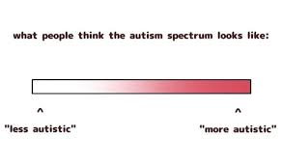
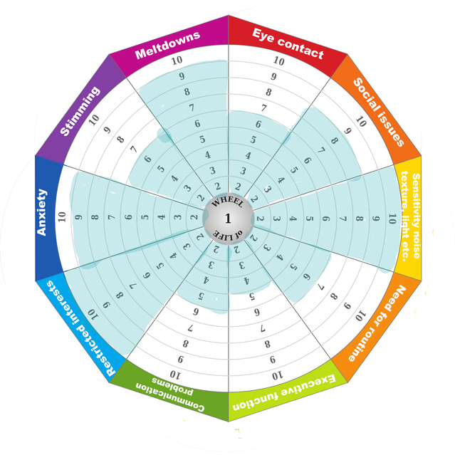
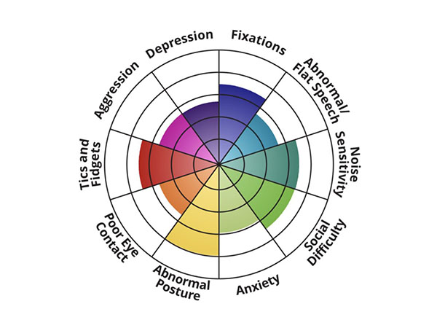
The Autism Wheel vs the Linear Spectrum
Wheel 1:
Wheel 2:
16
From Autistic Linear Spectrum to Pie Chart Spectrum | Psychology Today & Why the Autism Wheel is replacing the Spectrum - AbleLight Blog
Notes:
The Autism Wheel- also the Autism Pie Chart Spectrum is something I want to go into next. There is consideration to shift Autism from a linear perspective to more of a wheel shaped perspective. This would help to eliminate the “level/severity buckets” as well as break away from the buckets of a “good” vs “bad” classification of Autism presentation as seen on the linear model. i.e., one side is low functioning and the other end is high functioning. This also plays into stereotype that people that are low functioning have ID. The wheel aims to be a visual of autistic traits that reflect an individuals experience and a way to visualize and highlight strengths within their own world rather than comparing it to a “neurotypical model”. It is a way to show how different Autism is for everyone. It also allows reflection of traits to change and develop over time. There are different models of different types of wheels- they are unable to include all autistic traits but still serve to highlight there isn’t one good or bad type of autism- it’s just an individualized perspective. There is still a lot more to come on these wheels- I just wanted to keep you up with the latest findings and discussions out there.

Slide 17
Challenging Stigmas & Stereotypes
TEDx Austin College: “Behind the Mask: Autism for Women and Girls” as presented by Kate Khale
https://www.youtube.com/watch?v=Tbes1mm2VgM
Notes:
As we near the end of this. I want to share 1 more TED talk by an individual with Autism. I want you to highlight her description of autism, why she doesn’t want to be referred to as having Asperberger’s Syndrome and her explanation of the Autism Wheel.

Slide 18
Hearing & Honoring Autistic Voices
A few things I picked up on were…
“Neurotypical people might think that autistic people are insecure or manipulative for trying to hide our symptoms. This isn’t true. The real reason an autistic person would mask is because of a natural human desire to fit in and connect with others and achieve social and professional success”
“Think about this, when you’re having a conversation with somebody you are doing a lot of things at once. You have the correct posture, you’re the right distance away from them, you’re using the right facial expressions, you’re modulating your tone, you might be gesturing, you’re making the right amount of eye contact, you’re not not looking them in the eyes but you’re not looking them in the eyes so much that it’s creepy and you’re predicting what the other person is going to say or do next. For the neurotypical people all these things come naturally, and you guys don’t need to think about them but for me I have to think about all those things at once.”
Notes:
1 more thing that was new to me was the background regarding Hans Asperberger. This is why it’s so important to ask how people want to be referenced.

Slide 19
The Next Steps to Get Involved & Show Support
Notes:
So last- we will move to next steps and how to get involved.

Slide 20
Get Involved & Show Support
Awareness
Unconditional acceptance of Autism
Learn about Neurodiversity and educate yourself
Connect with Autistic Individuals
Identify yourself as an Autism Ally
Do not use ableist language
Support organizations that are run by Autistic individuals or partnered with Autistic Individuals
Light it up “Red”, “Gold”, or with “Color”
Acceptance cannot occur without Autistics
Acceptance
Action
Autism Spectrum Disorder
Connection
Advocacy
Notes:
Even though this is a mandated training- this is one way you are getting involved and educating yourself about Autism Acceptance. These are just a few ideas or ways you can show your support this month. I will also be sending out weekly activities throughout this month which you are all more than welcome to take part in
Abeleist language- anything that makes someone inferior or less than.
For example- don’t say someone is low functioning- say someone needs more supports.
Don’t say this individual is challenging. Say the environment challenges this person.
Avoid anything in a bullying, lack of understanding, ignorant nature

Slide 21
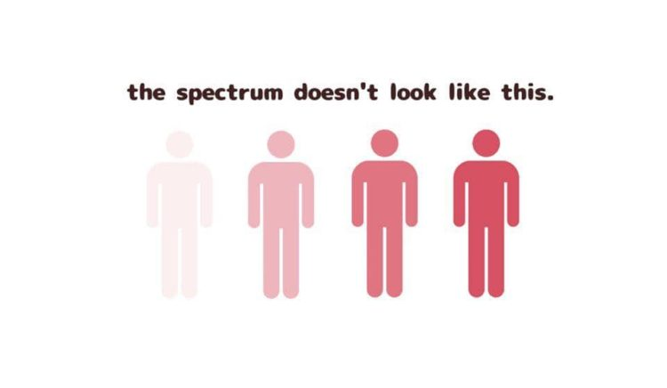
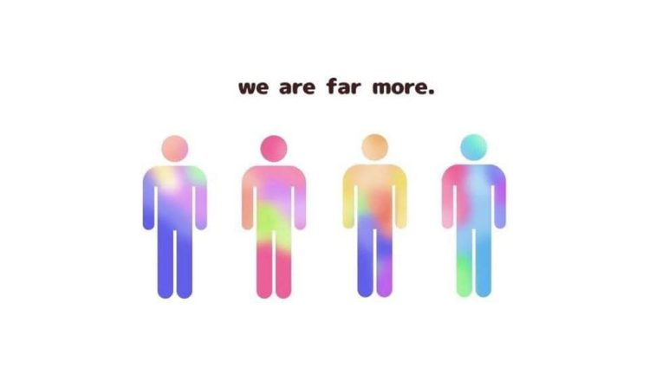
This Graphic Shows What the Autism Spectrum Really Looks Like (themighty.com)

Slide 23
Confidentiality statement
The information presented in this presentation is confidential and expected to be used solely in support of the delivery of services to Magellan members. By receipt of this presentation, each recipient agrees that the information contained herein will be kept confidential and that the information will not be photocopied, reproduced, or distributed to or disclosed to others at any time without the prior written consent of Magellan Health, Inc., a subsidiary of Centene Corporation.
The information contained in this presentation is intended for educational purposes only and should not be considered legal advice. Recipients are encouraged to obtain legal guidance from their own legal advisors.
Notes:
for providers

