Slide 1
IBHS Refresher:
Core Assessment
&
Treatment Planning
Skills
Keisha Moeller, MS BCBA LBS Autism Clinical Care Manager
John Siegler, Psy.D. Psychologist Advisor
Magellan Behavioral Health of PA
July 2022

Slide 2
Agenda
Assessment
Choosing behavioral targets for assessment
Setting specific assessments
Methods of assessment
Functional assessment
Identifying barriers
Tracking meaningful indicators of change
Treatment Planning
Using Assessment results to prioritize treatment goals
Writing Goals and Objectives that describe observable behaviors
Linking decisions about treatment interventions to assessment results
Remediating Skill Deficits
Writing Parent goals that reflect specific skills to be transferred.
Notes:
Purpose of better assessment and treatment POLL

Slide 3
Conceptual Framework: Achieving a Good Fit
Child
Environment
Notes:
So often, the focus of assessment is primarily on the child. The child did this X times per min, for 20 mins, with moderate intensity, causing significant functional impairment, etc. This data is critically important but is not the whole story.
We must be equally curious about the environment.
The child’s behaviors are in response to the environment at the time that the behavior occurs.
We are focused on changing child behavior, and we usually have to manipulate the environment including changing adult behaviors) along the way.
The question: “what happened before the behavior occurred?” and “what happened after the behavior occurred ?” are crucial to understanding the starting point for the journey and how to get to the destination.
While some of you may role your eyes, a lack of focus on the environment during the assessment process is the most likely reason why intervention choice is often generic, why caregiver goals/objectives are generic, why transfer of skills is difficult, and why barriers to progress are so common.
Achieving Goodness of Fit is crucial to

Slide 4
What is Assessment?
According to Merriam Webster, "the action or an instance of making a judgement about something; the act of assessing something".
Actions consist of measuring, observing, documenting, interviewing, probing, etc.
Judgement consists of forming an opinion by "discerning or comparing".
Clinical Assessment involves the evaluation of a person's functioning in multiple areas to inform and facilitate treatment decisions intended to improve functioning (Encyclopedia of Mental Health, 2nd Ed. 2016).

Slide 5
Why Assessment?
BACB Ethics Code 2.13 Selecting, Designing, and Implementing Assessments Before selecting or designing behavior-change interventions behavior analysts select and design assessments that are conceptually consistent with behavioral principles; that are based on scientific evidence; and that best meet the diverse needs, context, and resources of the client and stakeholders. They select, design, and implement assessments with a focus on maximizing benefits and minimizing risk of harm to the client and stakeholders. They summarize the procedures and results in writing.
APA Ethical Principals of Psychologists and Code of Conduct (2017) Section 9: Assessment

Slide 6
Why Assessment?
It's required by regulation!
A face-to-face assessment has been completed by an individual qualified to provide behavior consultation services or mobile therapy services within 15 days of the initiation of individual services and prior to completing the ITP in accordance with § 5240.21 (relating to assessment) or a face-to-face assessment has been reviewed and updated within 12 months of the previous face-to-face assessment.
A face-to-face assessment has been completed by an individual qualified to provide behavior analytic services or behavior consultation-ABA services within 30 days of the initiation of ABA services and prior to completing the ITP in accordance with § 5240.85 (relating to assessment) or a face-to-face assessment has been reviewed and updated within 12 months of the previous face-to-face assessment.
A face-to-face assessment has been completed by a graduate-level professional within 15 days of the initiation of group services and prior to completing the ITP in accordance with § 5240.95 (relating to assessment) or a face-to-face assessment has been reviewed and updated within 12 months of the previous face-to-face assessment.

Slide 7
Indirect Assessment
Indirect – information obtained from external sources.
  Record Review
    Medical
    Educational
    Prior Treatment History
    Medication Management
    Other Systems Involvement
  Interview
  Questionnaires
  Rating Scales

Slide 8
Indirect Assessment
Domain | Examples of Assessment Tools
Adaptive Functioning | Strengths and Difficulties Questionnaire (SDQ); Vineland – 3 (Parent/ Caregiver or Teacher forms); Adaptive Behavior Assessment System 3rd Ed. (ABAS-3, Parent/ Caregiver or Teacher forms);
Behavior Scales (Parent & Teacher) | Child Behavior Checklist & Teacher Rating Form; Conners 3rd Ed.; NICHQ Vanderbilt; Behavior Assessment Scale for Children 3rd Ed. (BASC-3)
Autism | Child Autism Rating Scale 2nd Ed. (CARS-2); Gilliam Autism Rating Scale 3rd Ed. (GARS-3
Depression | Patient Health Questionnaire (PHQ); Children’s Depression Inventory 2nd Ed.(CDI-2)
Anxiety | Screen for Child Anxiety Related Disorders (SCARED); Patient Health Questionnaire (PHQ), Multidimensional Anxiety Scale for Children 2nd Ed. (MASC-2)
Substance Abuse | Drug Abuse Screening Test (DAST-10)
Social Skills | Social Responsiveness Scale 2nd Ed. (SRS-2); Social Communication Questionnaire (SCQ)
Trauma | Children’s Impact of Event Scale-13 (CRIED-13); Trauma Symptom Checklist (TSCC)
ABA Questionnaires | Functional Analysis Screening Tool (FAST); Questions About Behavioral Function (QABF); Motivation Assessment Scale (MAS)
Notes:
These are not standalone tools and without confirmation thru observation, testing, etc., the validity of the outcomes will always be a concern.

Slide 9
A word about Adaptive Functioning
Assessment of Adaptive Functioning (Vineland or ABAS-3) is required for IBHS-ABA
Important to remind respondents to “Keep in 100” do not give credit for skills not observed.
Consider where services are being delivered when choosing respondents (if BHT is recommended in school, teacher should complete Vineland/ABAS too.)
Ideal if both parent and teacher complete the Vineland/ABAS
WHY?
  Compare perspectives on Mbr behavior across settings.
  Increase confidence in assessment in areas of agreement.
  Find out about setting specific needs

Slide 10

3 commonly used ABA Questionnaires
Motivation Assessment Scale https://thebubblybehaviorist.files.wordpress.com/2018/01/motivationassessmentscale.pdf
Questions About Behavioral Function https://arbss.org/wp-content/uploads/2021/05/Questions-about-Behavioral-Function-QABF-Google-Docs.pdf
Functional Assessment Screening Tool https://www.cmhcm.org/userfiles/filemanager/961/

Slide 11
A word about ABA Questionnaires
Not just for IBHS-ABA
Easy to use – can score and review results in session
Please use 1 type of Questionnaire (i.e., QABF, FAST, MAS) with Caregiver(s)
Use 1 Questionnaire in all settings where Mbr is receiving BHT (home, school/daycare)
Do not use 1 type of questionnaire in one setting and a different type in another setting (example: teacher completes FAST, parent completes QABF)

Slide 12
Direct Assessment – Part I: Direct Observation
Information obtained from face-to-face interaction, testing, probing, observation of the member in the environment in which the problem occurs
  Functional Behavior Assessment
    Functional Experimental Analysis (Confirmation of function through testing)
      Brief FA
      Trial Based FA
      Synthesized FA (Hanley IISCA)
      Latency Based FA
      Precursor FA
    Descriptive FBA (Hypothesized function based on data collected)
      ABC Continuous Recording
      ABC Narrative Recording – Most popular BUT seldom reported in published research….

Slide 13
Direct Assessment – Part II: Interactive Assessments
Information obtained from face-to-face interaction, testing, probing, observation of the member in the environment in which the problem occur
Mental Status Examination
Suicide Risk Assessment
Functional Communication
Skills Based Assessments
Ecological Assessment
Notes:
What is going on with the Caregivers?

Slide 14
A word about Suicide Risk Assessment
Screening for suicide risk is necessary as part of initial and subsequent assessment with neurotypical and high functioning neurodiverse Mbr’s
Screening tool Columbia-Suicide Severity Risk Scale
  Accessible
  Assesses Ideation and Behavior
  Guides decisions about next steps
Responding to Suicidal Ideation – Take training seriously
Suicidal Ideation requires the clinician to PIVOT and focus on reducing the suicide risk
Use session tools (i.e., SUICIDE STATUS FORM–4) for ongoing assessment

Slide 15
SUICIDE STATUS FORM–4 (SSF-4)

Slide 16
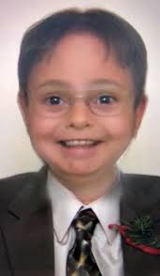
Assessment – Case Scenario
You accept a referral for a new client, Dwight, who is 9 years old, diagnosed with ADHD. Parents report significant problem behaviors in the home and conflict with the older sibling. Parents report that in school, the teacher is frustrated with having to provide so much additional support for the client to pay attention. In addition to home and school, the client participates in Boys and Girls club once per week.

Slide 17
Step One: What resources/tools are needed to obtain information about the problem?
Based on what is described, determine what Assessment tools would be useful in obtaining additional information about the problem. Choose tools that "Match".
When would an FBA/FA NOT be used?

Slide 18
Step Two: What is the problem?
What is the problem?
Generate an operational description of the problem. An initial description based on indirect assessment information can be updated, revised or confirmed based on your direct assessment later in the process.
Non-compliance is when Dwight doesn't listen, is disrespectful, insists on doing things his way.
Non-compliance is when Dwight says "No", "Maybe later" when asked to answer questions by the teacher during group instruction. Noncompliance is when Dwight engages in any response that doesn’t match the instruction given within 5 seconds.

Slide 19

Avoid Vague Labels and Doing Too Much
OR

Slide 20
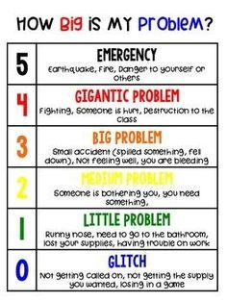
Step Three: Why is it a problem?
Prioritize - "When everything is a priority, nothing is a priority."
Is it harmful to self or others?
Does it limit access to social opportunities/environments?
Does it impact the ability to remain in the least restrictive setting with least intrusive supports?
Whose problem is it?
Is the problem within your scope of competence/practice?
Is it likely that the problem will change?

Slide 21

Step Four: Where/when does it present as a problem?
Go to where the problem is reported to be occurring, when it is reported to occur.

Slide 22
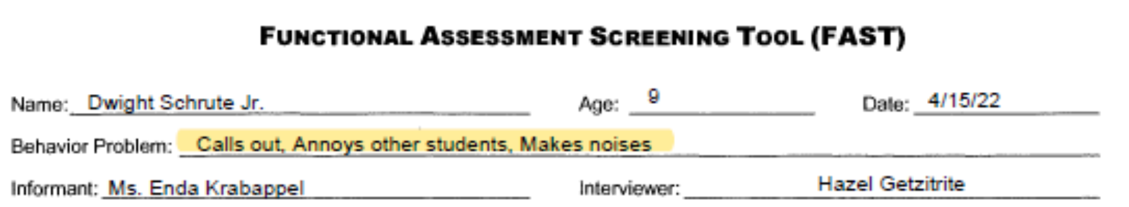
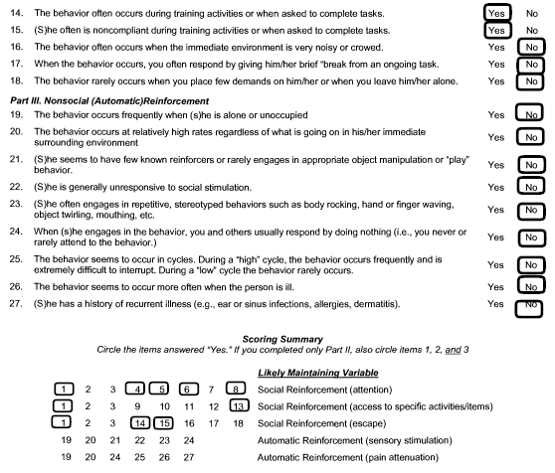
Let’s look at some data from Dwight’s teacher

Slide 23
Let’s look at some data from Mrs. Schrute

Slide 24
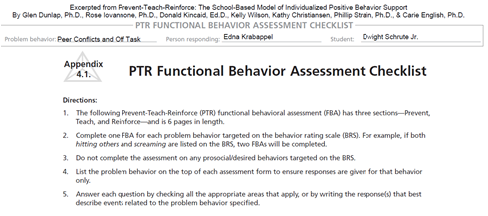
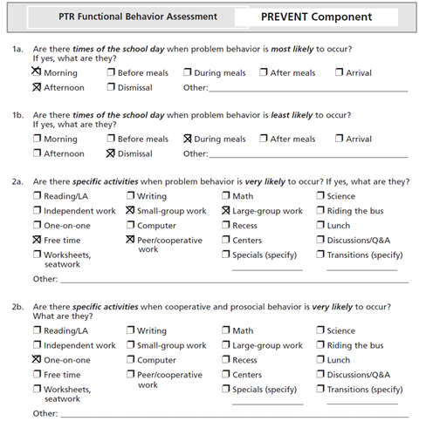
The PTR FBA with Ms. Krabappel revealed Antecedents

Slide 25
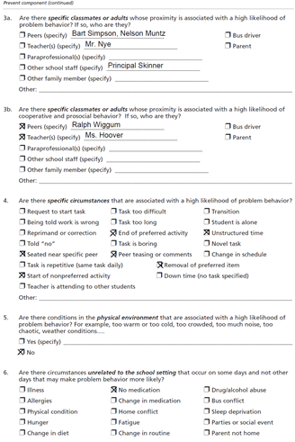
More Antecedents

Slide 26
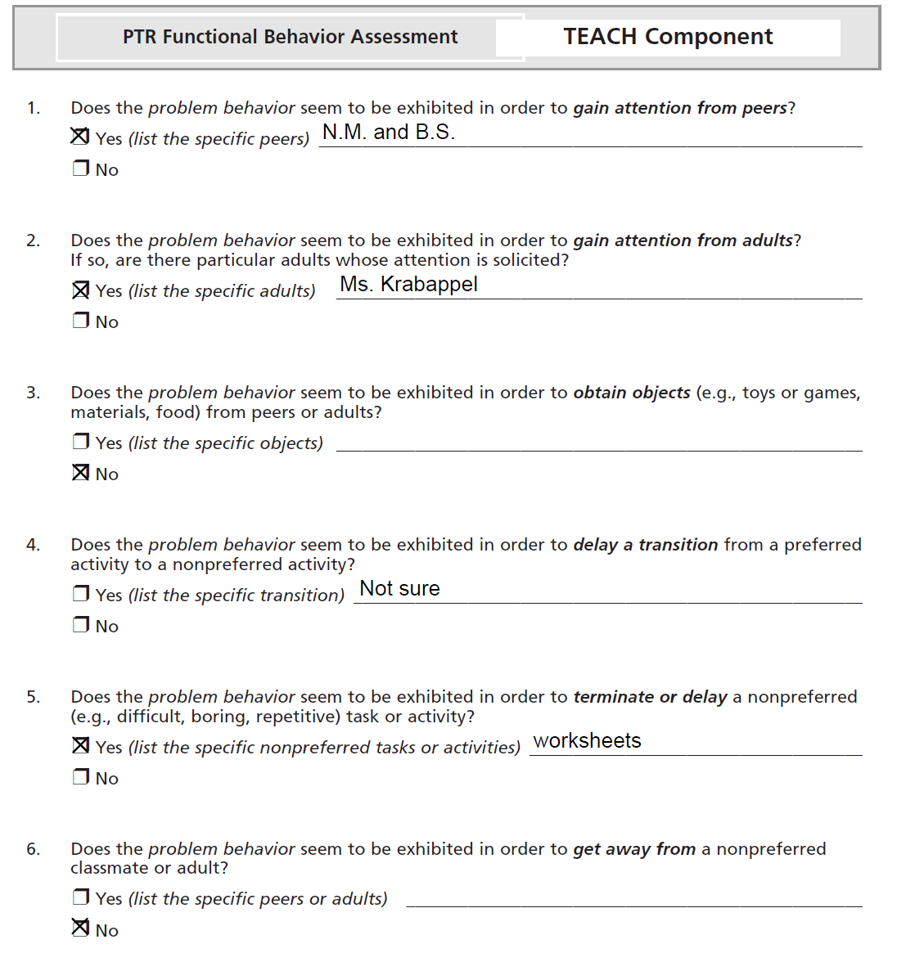
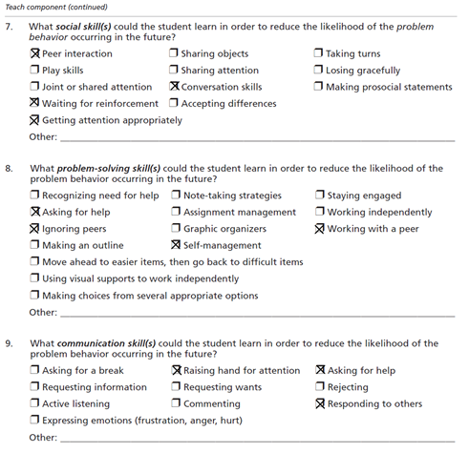
Skill deficits

Slide 27
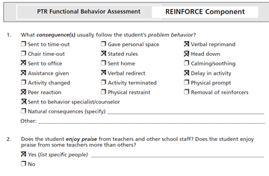
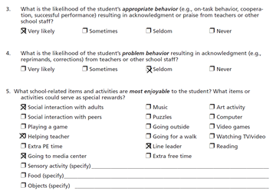
What is reinforcing
Notes:
The BC wants to engage the teacher and get a commitment from the teacher to utilize specific interventions and avoid responding in ways that may reinforce problem behaviors.

Slide 28
Step Five: Identify what is contributing to the problem.
Context/Setting | Antecedents | Behavior | Consequences
School | Teacher or peer present Free Time Small Group Work Lg. Group Work Bart & Nelson Principal Skinner End of Preferred Task Start of non-preferred Seated near (Nelson or Bart) Peer Teasing Unstructured time Remove Preferred item | Calls out Annoys others Makes noises | Sent to Office Assistance given Peer reaction Sent to Behavior Consultant Stated rules Verbal redirect Delay in activity
Home | When parent or sibling is present | Get’s upset easily Teases siblings | Parent interacts with Dwight Gets access to tablet

Slide 29
Identifying Barriers
Per Merriam-Webster, “…a fence or other obstacle that prevents movement of access“.
Scheduling/availability
Engagement/Participation
Medical complications
Resources
Co-morbidities/Dual Diagnosis
Social Determinants Of Health
Notes:
Andrade, L. H., Alonso, J., Mneimneh, Z., Wells, J. E., Al-Hamzawi, A., Borges, G., Bromet, E., Bruffaerts, R., de Girolamo, G., de Graaf, R., Florescu, S., Gureje, O., Hinkov, H. R., Hu, C., Huang, Y., Hwang, I., Jin, R., Karam, E. G., Kovess-Masfety, V., Levinson, D., … Kessler, R. C. (2014). Barriers to mental health treatment: results from the WHO World Mental Health surveys. Psychological medicine, 44(6), 1303–1317. https://doi.org/10.1017/S003329171300194

Slide 30
Tracking meaningful indicators of change
Pre-test/Post-test; Reassessment using Criterion referenced tools¹
Check In/Check Out
Self report
  CORS & CSRS
  Feelings Chart
Direct measurement – Has to be qualified; when, where, under what conditions and how many times was data recorded to establish measure?
  Frequency/rate
  Duration
  Intensity
Sampling
  Interval recording
¹Criterion-referenced tests compare a person’s skills against a predetermined standard
Notes:
Direct Measurement see next slide

Slide 31
Tools Supporting Engagement and Session Focus

Slide 32
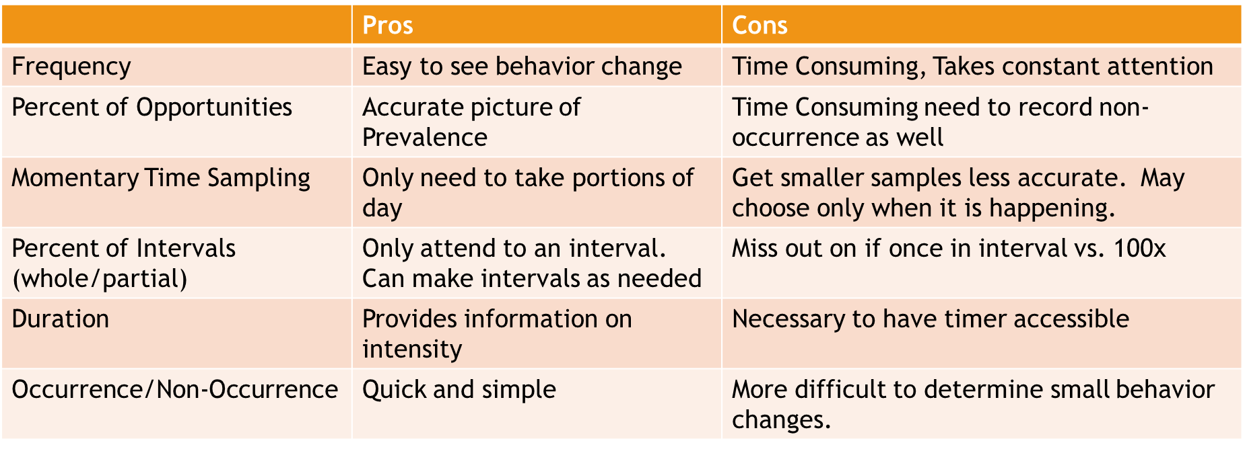
Choosing a Data Collection System
Notes:
This is a useful table displaying the pros and cons of different approaches to collecting data
Frequency – a necessary dimension of problem behavior that you need to measure. Some behaviors occur often, and some are infrequent. Changes in frequency can be a meaningful measure of progress.
Frequency counts - Counting behaviors by continuous sampling (how many times per minute or hour) is sensitive to change with high frequency behaviors
Momentary Time Sampling – taking observations at predetermined intervals (every 15, 20, 30 sec) is a useful frequency measure for some behaviors i.e., measuring on-task vs off task and the type of off-task behavior (talking, walking around, etc.)
Partial/Whole Interval Sampling – what percentage of an interval is the behavior observed.
Duration – a necessary dimension of problem behavior that must be measured. More meaningful for some behaviors (episodic like tantrums, elopement, and other behaviors where shortening the duration might be an important measure of progress.
Occurrence/Non-Occurrence - is most relevant when we have identified triggers and we want to say something about the child’s progress in an all or nothing way. Screams when toilet is flushed vs does not scream when toilet is flushed.
Not mentioned here is the dimension of Intensity. There are many scales available for determining intensity. Two things I would say on this issue.
Be consistent and try to anchor your intensity scale to something measurable
Questions on this slide or comments?

Slide 33
Using assessment results to prioritize treatment goals
Is it harmful to self or others?
Does it limit access to social opportunities/environments?
Does it impact the ability to remain in the least restrictive setting with least intrusive supports?
Whose problem is it?
Is the problem within your scope of competence/practice?
Is it likely that the problem will change?
Is the problem the problem, or an attempted solution to a problem?

Slide 34
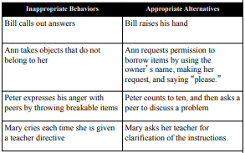
Writing goals & objectives that describe observable behaviors
Descriptive – Observable
Measurable (can be reliably measured)
Where, with what, when, or how the response is to occur
An acceptable level of performance (Are we there yet?)
Limit Goals to distinct, separately occurring behaviors
Think about what progress looks like

Slide 35
Baseline information (current levels)
Collecting baseline data in all quantifiable relevant dimension(s):
Frequency: how often?
Intensity: impact? (depth, force, strength)
Duration: how long?
Threshold and Range (i.e., elopement)
  What is the minimum distance to count
  What is the longest duration and/or farthest distance

Slide 36
Linking decisions about interventions to assessment results
What does the data tell us about the Member’s needs?
Are problem behaviors easily linked to missing skills
Behavior is communication
Intervention is about:
  Controlling how people respond to the problem behaviors (prevent unintentional reinforcement)
  Reinforcing /Teaching skills that provide the Member with an alternative response

Slide 37
What is a functional based intervention?
Function-Based Intervention is an action plan that is developed by taking into consideration the information obtained from the Functional Behavior Assessment and must addresses the purpose that the behavior serves for the child.
The Functionally Equivalent Replacement Behavior (FERB) is a positive alternative that allows the student to obtain the same outcome that the challenging behavior provided; that is, the student can obtain or escape something in their environment in an appropriate, acceptable way.
To qualify as appropriate and acceptable, the FERB:
  Must serve the same function as the problem behavior.
  Is NOT the absence of the problem behavior nor the presence of general desired behavior (e.g., "student will comply with directions"; "student will complete work when asked").
  Allows the student to get desired outcome in a more adaptive and socially acceptable manner.
  Is something the student does (not done by staff or peer).
  Is in the student's repertoire or easily shaped, and represents the beginning point for teaching desired behavior.
  Is as efficient to perform as the problem behavior.
  Have good contextual fit with the setting and situation.
Notes:
Or FEAR - Functional Equivalent Alternative Response

Slide 38
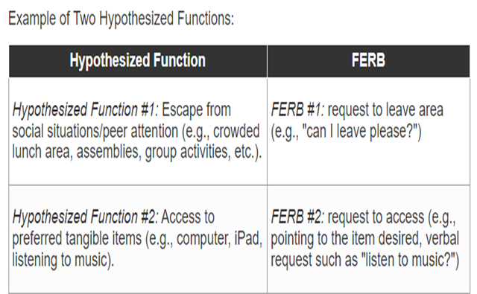
If multiple, distinct functions were identified (e.g., escape AND tangible access), multiple FERBs must also be identified.

Slide 39
Examples and Non-Examples: Escape
Hypothesized
FERB
Example or
Explanation
Function
Non
-
Example?
Escape
Teacher will reduce number of
Non
-
Example
This is a good example of an antecedent
problems the student completes.
Antecedent
intervention or environmental support,
intervention
which reduces the likelihood the student
will need to use challenging behavior to
escape. However, it does not meet criteria
1
-
7 for a FERB as this is NOT a behavior
that the student does themselves.
Escape
Student will complete work at
Non
-
Example
This is a general positive behavior that
their desk.
General
could be targeted for increase but does
positive
not have functional equivalence to the
behavior
function of behavior (i.e., it does not allow
the student to appropriately escape).
Escape
Student will request to stop
Example
This meets criteria 1
-
7 for a FERB
doing the work/ assignment or to
leave the work area.
Notes:
POLL

Slide 40
Examples and Non-Examples: Attention (from adults)
Hypothesized Function | FERB | Example or Non-Example? | Explanation
Attention (from adults) | Staff will provide non-contingent attention to the student. | Non-Example Not a behavior the student performs | This is not a behavior that the student engages in, rather, it is an example of an environmental support that the adult provides.
Attention (from adults) | Student will request a break. | Non-Example No Functional Equivalence | There is no direct connection or functional equivalence between the function and FERB. Function is to access attention, but by requesting a break, student will not receive the attention they desire.
Attention (from adults) | Student will request to play a game or to talk with an adult. | Example | This meets criteria 1-7 for a FERB

Slide 41
Examples and Non-Examples: Attention (from adults)
Hypothesized
FERB
Example or Non
-
Explanation
Function
Example?
Attention (from
Staff will provide
Non
-
Example
This is not a behavior that the
adults)
non
-
contingent
Not a behavior the
student engages in, rather, it is an
attention to the
student performs
example of an environmental
student.
support that the adult provides.
Attention (from
Student will
Non
-
Example
There is no direct connection or
adults)
request a break.
No Functional
functional equivalence between the
Equivalence
function and FERB. Function is to
access attention, but by requesting a
break, student will not receive the
attention they desire.
This meets criteria 1
-
Attention (from
Student will
Example
7 for a FERB
adults)
request to play a
game or to talk
with an adult.

Slide 42
Remediating skill deficits
What are essential skills that the Member does not seem to use?
Does the Member know how to perform a particular skill, or must it be taught?
Does the Member know when to perform a particular skill, or must it be taught?
  When skills are present but not demonstrated or performed
  Avoid excessive prompting
  The Member's task is to recognize the context where the skill should be performed.

Slide 43
Writing Caregiver goals
What can parents/teachers learn to more consistently support the Member’s learning?
Teach the Caregiver to
  Praise
  Ignore
  Request
  Anticipate
Don’t Play the Blame Game.
When a Caregiver does not use a skill we must ask why?
What is interfering?
  Do they know what to do?
  Do they know when to do it?
What is the function of the Caregiver behavior we want to change?
What strategies can we try to increase motivation?

Slide 44
Parent Goal Examples
Goal 1: Caregiver will implement at least 2 antecedent strategies in Member’s behavior plan to reduce challenging behaviors in 80% of measured opportunities.
Target Date:
Mastery Criteria: 80% of measured opportunities maintained across 3 cold probes.
Baseline Date:
Baseline Data: Per direct observation, parent implemented at least 2 antecedent strategies in 50% of measured opportunities.
Goal 2 : Caregiver will limit verbals and direct eye contact when Member is engaging in behaviors targeted for reduction in 80% of measured opportunities.
Target Date:
Mastery Criteria: 80% of measured opportunities maintained across 3 cold probes.
Baseline Date:
Baseline Data: Per direct observation, parent limited verbals and direct eye contact in 25% of measured opportunities.
Goal 3 : Caregiver will implement at least 2 discrete trial programs with Member to target language skills with him in 80% of measured opportunities.
Target Date:
Mastery Criteria: 80% of measured opportunities maintained across 3 cold probes.
Baseline Date:
Baseline Data: Per direct observation, parent implemented 2 discrete trial programs in 0% of measured opportunities.

Slide 46
Confidentiality statement
By receipt of this presentation, each recipient agrees that the information contained herein will be kept confidential and that the information will not be photocopied, reproduced, or distributed to or disclosed to others at any time without the prior written consent of Magellan Health, Inc.
The information contained in this presentation is intended for educational purposes only and is not intended to define a standard of care or exclusive course of treatment, nor be a substitute for treatment.
Notes:
for educational presentations

