Slide 1
Welcome to the
Magellan Provider IBHS Workgroup
April 8, 2022

Slide 2
Welcome and Opening Remarks

Slide 3
Agenda
Updates from OMHSAS
Network Updates – Crystal Devine
Autism Acceptance Month – Emily Kocher, Lead Autism Care Manager
Clinical Tidbits
Magellan’s Data Driven Process
Upcoming Forums and Technical Assistance
Questions

Slide 4
Updates from OMHSAS

Slide 5
Suspended Regulations & Telehealth
All current OMHSAS suspended regulations have also been extended until 6/30/22.
To view a list of suspended regulations and their current status, please visit the DHS Suspended Regulations list.
Telehealth related waivers that have been granted with an April 1, 2022 start date will be good through March 31, 2023 and DO NOT need to be resubmitted. Should the legislation expire without another act, the waiver will be good for the remainder of the time period. If you have any questions, please email to ra-pwtbhs@pa.gov.
OMHSAS Behavioral Health Telehealth Information: https://www.dhs.pa.gov/Services/Mental-Health-In-PA/Pages/OMHSAS-Behavioral-Health-Telehealth.aspx

Slide 6
Child Protective Services Law Update
Child Protective Services Law Update
The Senate unanimously passed HB 764 on January 26th and the Governor signed HB 764 into law as Act 12 of 2022 on Thursday 2/17/22. These changes go into effect immediately. Act 12 amends the Child Protective Services Law to allow employers to hire an applicant on a provisional basis for up to 45 days. In order to do so, all of the following conditions must be met:
  The applicant is not applying for a position in a child-care institution as defined by 42 U.S.C. § 672(C)(2)(A) (relating to foster care maintenance payments program) or to be a foster or adoptive parent.
  The applicant must have applied for the necessary background checks (Pennsylvania Child Abuse History Clearance, Pennsylvania State Police Criminal Record Check and FBI Criminal History Background Check) and provide proof to the employer.
  The employer must have no knowledge of information that would disqualify the applicant.
  The applicant must affirm in writing they are not disqualified from employment by reason of being listed on the abuse registry or being convicted of a disqualifying offense.
  The employer, administrator, supervisor or other person responsible for employment decisions received the result of the applicant’s PA Child Abuse History Clearance AND either the Pennsylvania State Police Criminal Record Check OR the FBI Criminal History Background Check.
  If the results of the applicant’s background checks reveal that the applicant is disqualified from employment due to section 6344(c) (relating to grounds for denying employment or participation in program, activity or service), the applicant must be immediately dismissed by the employer, administrator, supervisor or other person responsible for employment decisions.
  The employer, administrator, supervisor or other person responsible for employment decisions requires that the applicant not be permitted to work alone with children and that the applicant work in the immediate vicinity of a permanent employee.
Notes:
Senate passed 764 on 1/26; governor signed Act 12 on 2/17/22. Changes in effect as of 1/1/22 technically. Allows employees to hire on provisional basis for up to 45 days. Had to get all clearances prior to hiring in the past. Need to have at least Child Abuse Clearance and then 1 of the other 2; have 45 days to get that 3rd missing clearance. Still need attestation for that employer to say they have nothing to preclude. Cannot work alone with kids during provisional hire. Updated IBHS FAQ about provisional hires. page 15 of FAQ #27

Slide 7
Magellan’s Discharge for IBHS
Magellan still requires IBHS providers to submit an online discharge form to us when a member is completely discharged from the IBHS level of care.
https://www.magellanprovider.com/news-publications/state-plan-eap-specific-information/pennsylvania-healthchoices/pa-healthchoices-discharge-form.aspx
This discharge form is a universal form and not specific to IBHS.
This form is not meant to meet the regulatory requirements. As a result, the provider may need their own discharge form which meets all the regulatory requirements which would be kept in the member’s chart.

Slide 8
IBHS Groups in Summer
Field Offices plan to add these site based group locations onto the licenses. If the location changes, they would do an addendum to the license.
OMHSAS stressed the need for providers to have clear clinical rationales for changes to a member’s group participation frequency (double/triple) which goes beyond not being in school.
Seeking summer group programming to be individualized.

Slide 9
Primary Insurance Issues
Magellan put together all the provider feedback about issues/concerns with specific Primary Insurances for OMHSAS. OMHSAS did present these to the PA Insurance Dept (PID). OMHSAS was meeting with PID on 3/10/22 and anticipated having some updates to report at our next OMHSAS/BH-MCO workgroup on 4/13/22.

Slide 10
Network Updates

Slide 11
Network Team
Mitch Fash – Network Manager – MFash@magellanhealth.com
Jess Pearce – Sr. Network Management Specialist – Cambria County- jpearce@magellanhealth.com
Michael Ditty – Network Management Specialist – Lehigh/Northampton Counties - msditty@magellanhealth.com
Crystal Devine – Network Management Specialist – Delaware & Montgomery Counties - cedevine@magellanhealth.com
Jessica Torano – Network Management Specialist – Bucks County - toranoj@magellanhealth.com
Jeff Stumm – Network Management Specialist – Contracts/Credentialing - jrstumm@magellanhealth.com
Alyssa Gorzelsky – Claims Resolution Specialist – amgorzelsky@magellanhealth.com

Slide 12
Telehealth Code
Magellan is aware of the changes to telehealth procedures with the Place of Service and modifiers. We continue to get guidance from the State on how these will be implemented and sustained. We anticipate an update to this guidance in July pertaining to PA HealthChoices.
Once this information is finalized, communication will be sent out to providers.

Slide 13
Satellite Sites & Licensing
IBHS licenses are issued regionally. There are 4 regional field offices: Western Field Office, Northeast Field Office, Southeast Field Office, and Central Field Office. A provider is only required to get multiple licenses if it provides services in multiple regions.
If a provider has multiple locations in one region, they do not need each site licensed, unless the site provides on-site services. However, your service description must include all locations under the regional license.
A provider is required to submit 1 service description for each IBHS license.
If a provider's service changes, an updated service description must be submitted to the licensing field office for approval. If a provider's address changes, a provider must notify OMHSAS's licensing field office and, if the provider is enrolled in MA, it must also notify MA enrollment.
*Not all locations in the region require MA enrollment unless providing on-site services*

Slide 14
Autism Acceptance Month

Slide 15

Autism Acceptance Month
Did you know April is Autism Acceptance month?
Why Acceptance and not Awareness?
How to show your support
  Be mindful of your language choice and avoid labels or stereotypes
  “Light it up Gold” or “Wear Red”
  Embrace differences
  Educate yourself and others
Notes:
Please join Magellan in celebrating Autism Acceptance month this April with resources gathered by Emily Kocher, Lead Autism Care Manager. As some are already aware, April was previously referred to as “Autism Awareness” month with April 2nd specifically highlighting “World Autism Day”. As of late, there has been an even greater call to shift the language from “Autism Awareness” to “Autism Acceptance”. This is to match the language and need for acceptance within our communities to promote integration and address barriers to developing supports. Awareness is always the goal, but the need is to start and build the foundation of acceptance first.

Slide 16
Autism Acceptance Month Resources
The Magellan of PA Autism Webpage has been updated to share more information on this initiative and contains PA based organizations that you can explore for additional resources and supports. https://www.magellanofpa.com/for-providers/services-programs/autism-resources/
Autism Society News Release: Media urged to recognize shift from “Autism Awareness Month” to “Autism Acceptance Month” this April- https://www.globenewswire.com/news-release/2021/03/04/2187484/0/en/Media-urged-to-recognize-shift-from-Autism-Awareness-Month-to-Autism-Acceptance-Month-this-April.html
Ask an Autistic- What is Autism?- https://www.youtube.com/watch?v=Vju1EbVVgP8
Carly’s Café- Experience Autism Through Carly’s Eyes- https://www.youtube.com/watch?v=KmDGvquzn2k
Sesame Street- Autism Acceptance & Sesame Street in Communities- https://www.sesameworkshop.org/what-we-do/autism
TedTalk: Temple Grandin- The world needs all kinds of mind- https://www.ted.com/talks/temple_grandin_the_world_needs_all_kinds_of_minds?language=en

Slide 17
Clinical Tidbits

Slide 18
Access Surveys
Thank you for your continued patience as we work through technical issues with the Access Survey.
We have made some edits based on using the survey for a year and to hopefully assist in being able to better manage the large amount of data this survey produces. However, there are no new questions to the survey.
Reminder: Although we send the survey to 2 agency representatives, please only have 1 complete the survey for your agency.

Slide 19
Family Feedback
Families are leaving messages inquiring about services and not receiving callbacks.
Families are frustrated having to go through intake process and complete all paperwork to hear there is no availability.
Families would like providers to be more upfront and direct about expectations and the process to get services.

Slide 20
Packets into Summer & Next School Year
Dates should reflect the end of the 2021-2022 school year, start of ESY, camps, etc., to accurately determine hours and corresponding units requested across services.
Requests for services in different settings and or the next school year should include an ISPT with a representative from that setting and be submitted no more than 60 days from the expected start date so that information used to support the request is current and accurately reflects the member's need.

Slide 21
New Groups under IBHS
*Please only initiate this process when your agency is ready to begin implementing group services if approved.
All new IBHS Group Services with Magellan need to complete the following process and receive approval from Magellan prior to delivering this group service to our members.
Submit a detailed program description to IBHS@MagellanHealth.com inclusive of:
  Address where group will occur
  target population (including primary & MA secondary participants)
  clinical model of program
  size of each group
  frequency of each group
  length of group (program duration and each sessions)
  if group is closed or open
  location of group
  family involvement
  Authorization period
  other relevant information
Email IBHS@magellanhealth.com requesting to schedule a Technical Assistance (TA) call with Magellan to review your program proposal.

Slide 22
In the works at Magellan…
Updates to Magellan IBHS webpage
Release of our Billing Guidance document
Release of our ABA Best Practices Guidelines
Meeting with Magellan approved Group providers (PA Mentor LV, Kids Peace, ABA Support Services, Neurabilities, Piece of our Puzzle, Potential, Indian Creek Foundation, Elwyn, & ACRP)

Slide 23
Reminder…
Please let your Care Manager know when your agency has changes such as within your organizational team, facility changes, significant program changes, etc.

Slide 24
Magellan’s Data Driven Process

Slide 25
CLINICAL MEASUREMENT TOOL
  In Q1, Care Managers reviewed 400+ member packets using our Clinical Measurement Tool.
  If there were specific concerns about MNG, a Collaborative Case Review was initiated.
  During April, the team is putting together all the data and will present each provider with a feedback form.
  The feedback form will show the member’s total scores.
  It will also show the data as a whole on each section: Written Order, Assessment, Individual Treatment Plan, Coordination of Care, CANS, MNG, and overall Total Score.

Slide 26
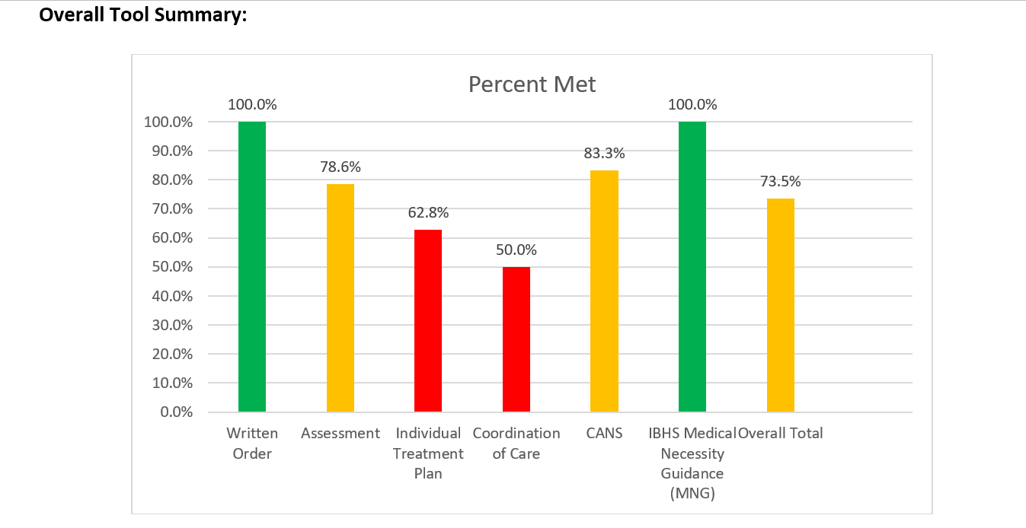
Sample Feedback Form

Slide 27
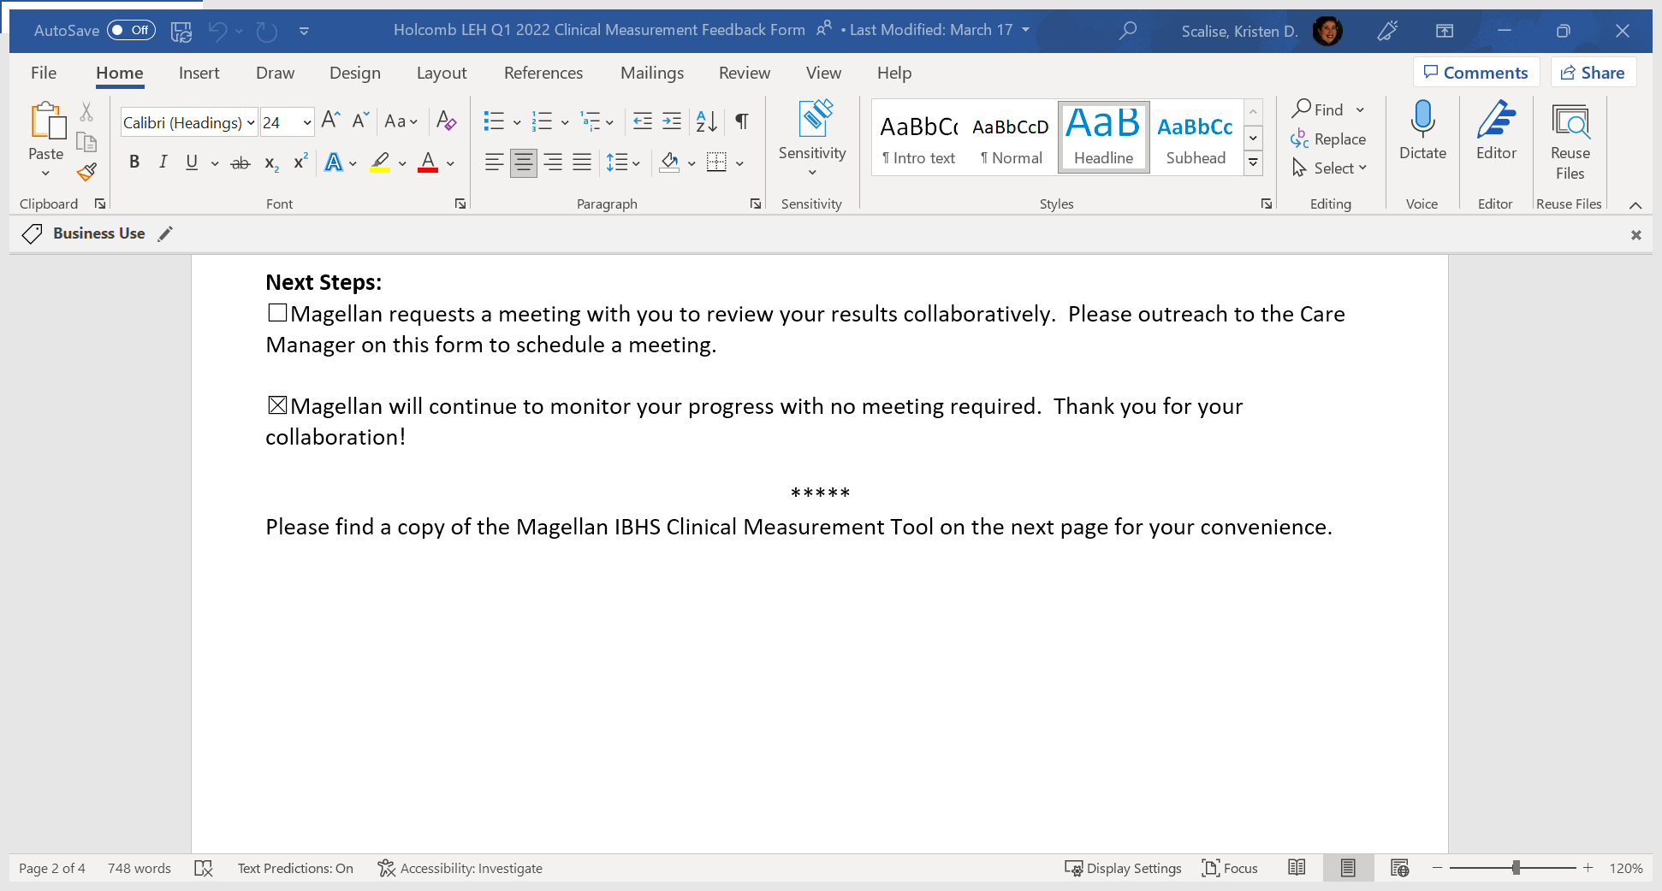
Sample – Request a meeting to review

Slide 28

Provider Initiated Phone Calls for FBS
Recommendations
Telephone call with Magellan Care Manager when considering a FBS referral.

Slide 29

Higher Level of Care Collaborative Phone Call
Magellan Care Manager will outreach provider for any IBHS member who is discharged from Acute Inpatient Program or Residential Treatment Facility within prior 30 days.
Goal: To ensure supportive transition from 24-hour level provider to community-based provider.

Slide 30
Medical Necessity Reviews
Care Managers will review some packets for Medical Necessity as they come in. However, this will be dramatically less than usual. Therefore, providers can anticipate a significant decline in Requests for Additional Information (RAIs) and Peer to Peer reviews.

Slide 31
Collaborative Case Review in Q2 & Q4
What: Telephonic review with provider for outlier cases
Content: Focus of treatment, progress, caregiver skillset, coordination of care, barriers, discharge planning
Goal: Discuss member’s treatment and efficacy of service. Collaborate on specific barriers for progress.
Focus of Treatment: [What are the primary concerns/issues addressed in sessions/ITP?]
Progress:
Caregiver Skillset: [How does caregiver currently intervene/assist? What skills need further development?]
Coordination of Care: [Current supports/services?, Contact with supports?]
Barriers: [What are the barriers for progress? Plan to address?]
Discharge Planning: [Anticipated dc, aftercare plan]
Plan/Next Steps: [Recommendations, Assistance needed]

Slide 32
Upcoming Forums &
Technical Assistance

Slide 33

Magellan’s Website Has a New Look

Slide 34
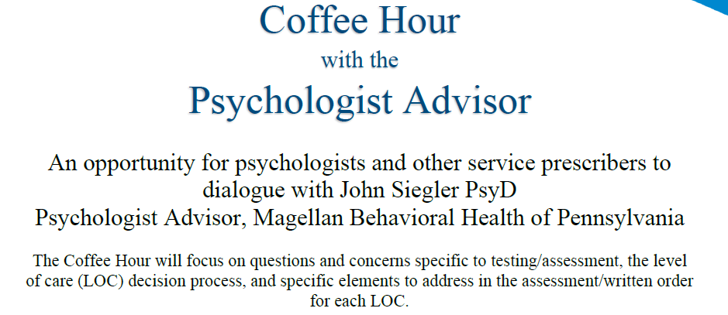
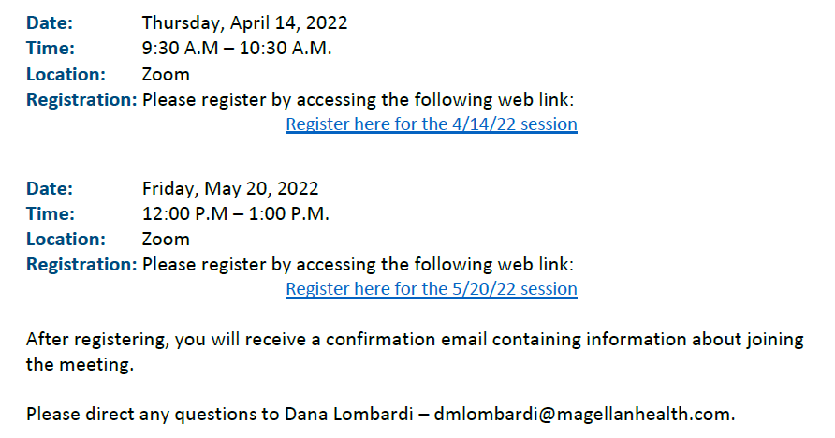

Slide 35
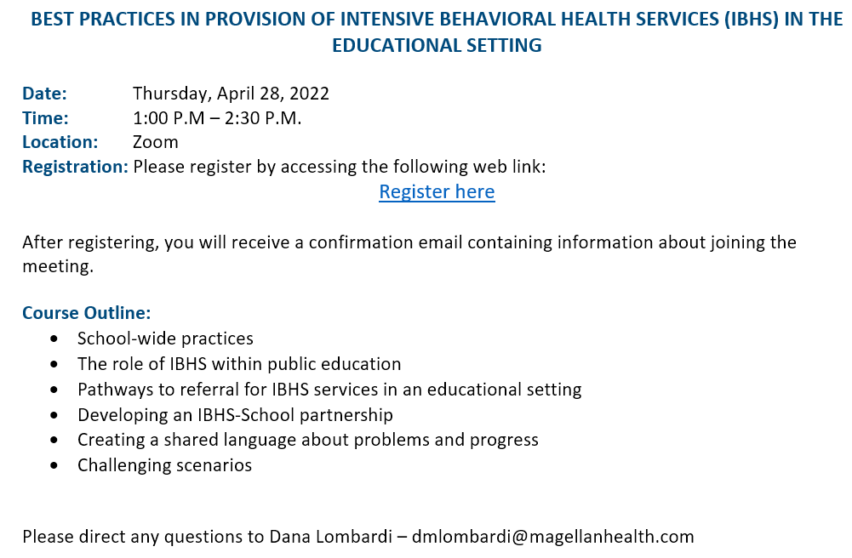

Slide 36
Q3 2022 IBHS Provider Forum
Thursday, August 18, 2022 10:00 to 11:30 A.M. Via Zoom
Register in advance for this meeting:
https://magellanhealth.zoom.us/j/95822509627?pwd=MGNyWHA1OWRyejFhS2FkL0Y2NmpSUT09
Password: 883659
After registering, you will receive a confirmation email containing information about joining the meeting.
This info can always be found at the bottom of our IBHS provider webpage:
https://www.magellanofpa.com/for-providers/services-programs/intensive-behavioral-health-services-ibhs/

Slide 37
Questions?

Slide 38
Thank you!

Slide 39
Confidentiality Statement for Providers
The information presented in this presentation is confidential and expected to be used solely in support of the delivery of services to Magellan members. By receipt of this presentation, each recipient agrees that the information contained herein will be kept confidential and that the information will not be photocopied, reproduced, or distributed to or disclosed to others at any time without the prior written consent of Magellan Health, Inc.
The information contained in this presentation is intended for educational purposes only and should not be considered legal advice. Recipients are encouraged to obtain legal guidance from their own legal advisors.

